Slide 1


Cyber Security Innovations
By: Raipudi Bhavana-22071A67B2

Slide 2

Importance of Cybersecurity in the Digital Age
1
Data Protection
2
Business Continuity
Cybersecurity safeguards sensitive data from unauthorized access, ensuring privacy and integrity.
Protecting systems from cyberattacks minimizes disruption and ensures smooth business operations.
3
Reputation Management
Strong cybersecurity practices build trust with customers and stakeholders, protecting brand reputation.

Slide 3

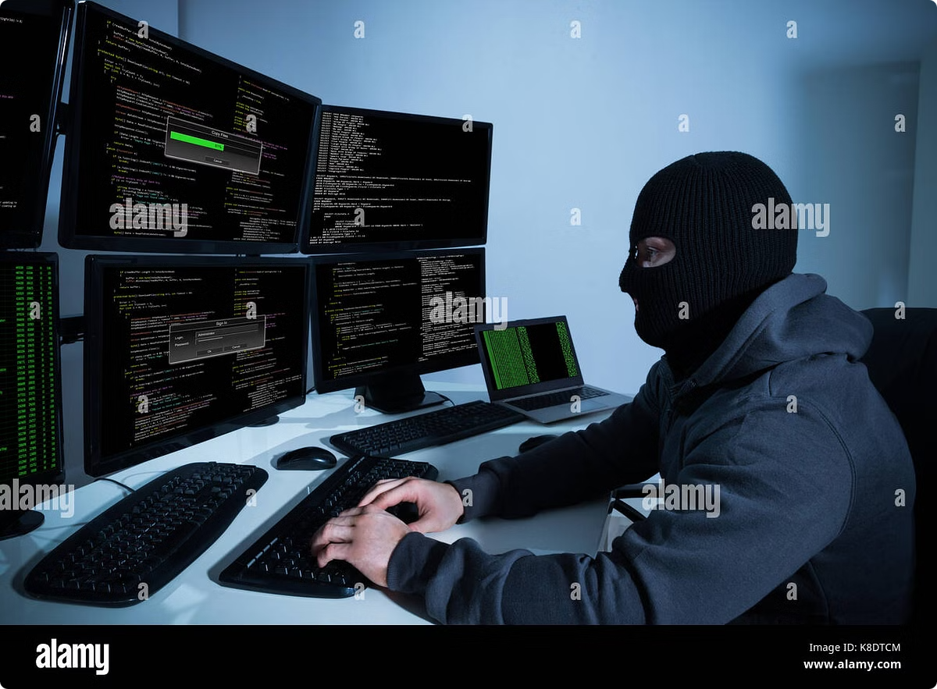
Emerging Threats and Trends
1
Ransomware
Malicious software that encrypts data and demands payment for its release.
2
Phishing
Deceptive attempts to obtain sensitive information through emails or websites.
3
Zero-Day Exploits
Vulnerabilities in software that are unknown to vendors and exploited before patches are released.

Slide 4
Blockchain for Secure Data Storage
Decentralization
Immutability
Transparency
Data is distributed across multiple nodes, making it resistant to single points of failure.
Once data is recorded on the blockchain, it cannot be altered or deleted, providing high integrity.
All transactions are publicly auditable, increasing accountability and trust.

Slide 5




Artificial Intelligence in Cyber Defense
Threat Detection
AI algorithms analyze data patterns to identify and respond to emerging threats.
Security Automation
AI can automate repetitive tasks like vulnerability scanning and incident response.
Adaptive Security
AI learns from past attacks and adapts security measures to prevent future threats.

Slide 6
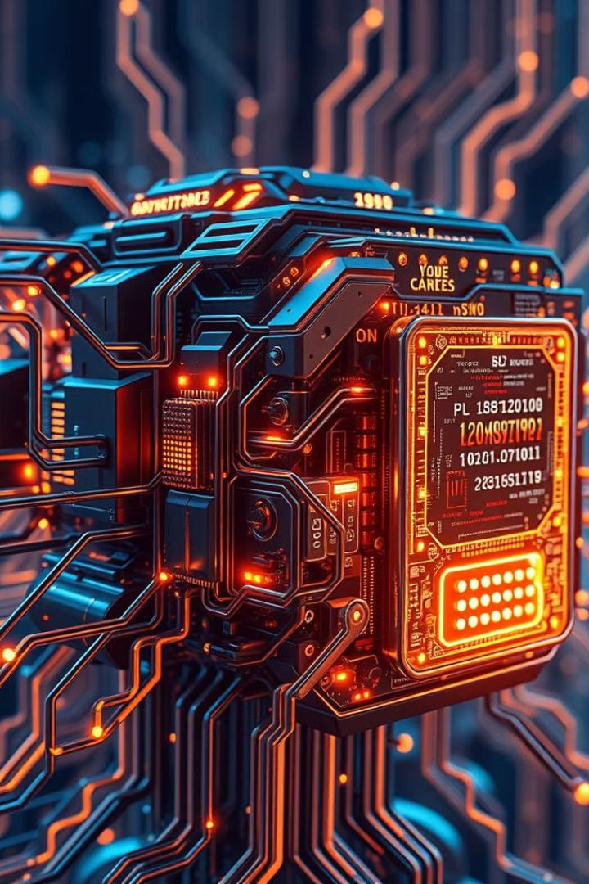
Quantum Cryptography: The Future of Encryption
Unbreakable Encryption
Post-Quantum Security
It provides security against future attacks from quantum computers, which could break current encryption methods.
Quantum cryptography leverages quantum mechanics to create encryption methods that are theoretically unbreakable.
Secure Communication
Quantum key distribution ensures secure communication channels, protecting sensitive data transmissions.

Slide 7

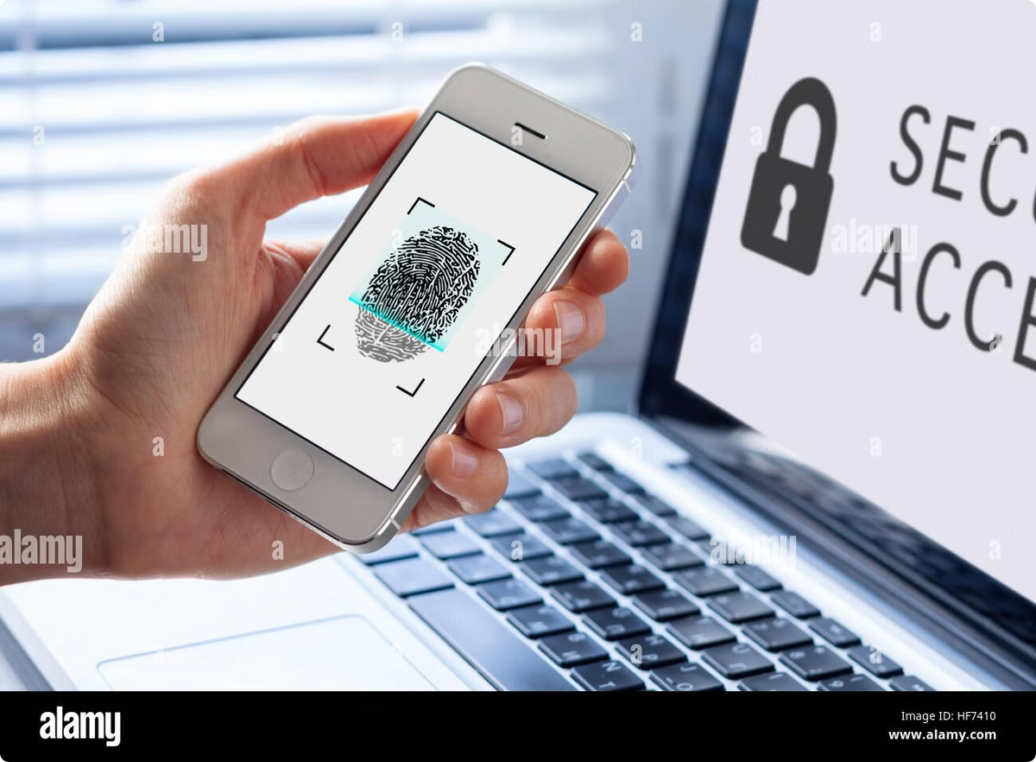




Biometric Authentication: Securing Access
Fingerprint Scanning
Facial Recognition
Uses unique fingerprint patterns for user authentication.
Analyzes facial features to verify identity.
Iris Scanning
Voice Recognition
Uses the unique patterns in the iris for identification.
Recognizes individual voice patterns for authentication.

Slide 8
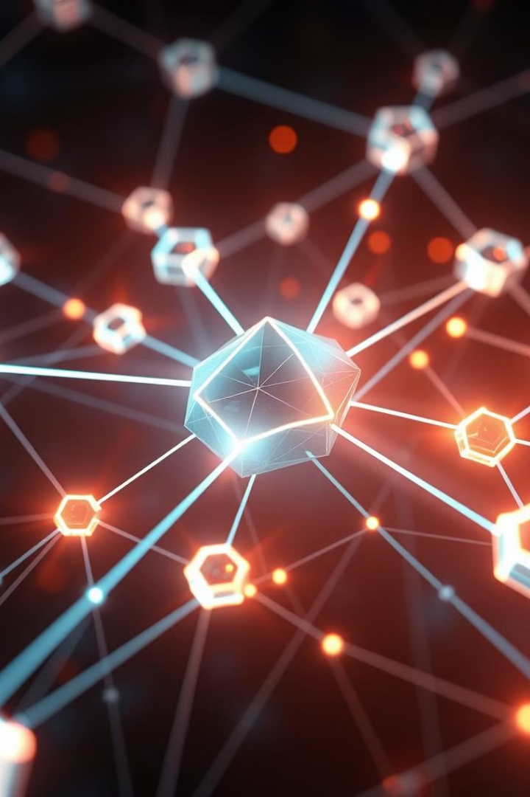
The Internet of Things and Cybersecurity Challenges
Increased Attack Surface
IoT devices create a vast network of potential entry points for attackers.
Vulnerabilities
IoT devices often have limited security features and can be easily compromised.
Data Privacy
IoT devices collect and transmit sensitive data, raising privacy concerns.

Slide 9

Conclusion: Staying Ahead of the Curve
Cybersecurity is an ongoing battle against evolving threats.
Staying informed about new technologies and best practices is crucial to maintaining robust defenses.

